Slide 1


FILM DIALOGUE
(BY GENDER)
SIERRA HESS

Slide 2
ABOUT THE DATA
Data is from the top 2000 cinematic movies of all time
Spoken lines of dialogue for male and female characters were tallied for each movie
The table looks at only the Disney movies in the dataset
Data & table are from Hanah Anderson & Matt Daniels

Slide 3
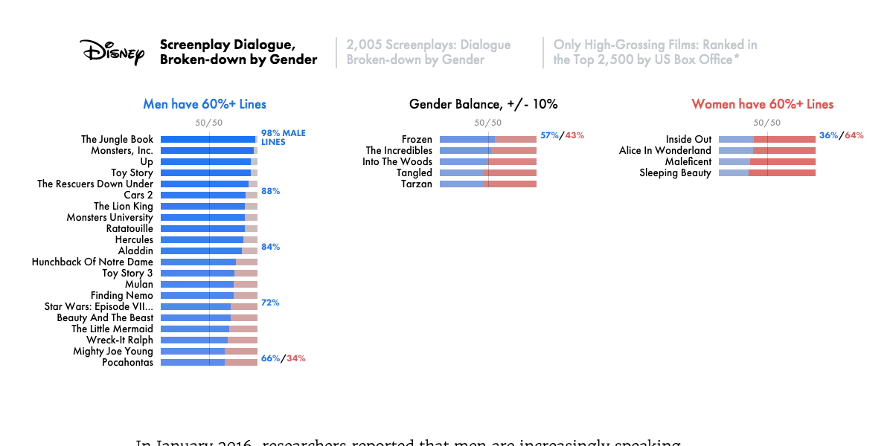
Findings:
# of movies with majority male/ female lines:
Male = 21
Balanced = 5
Female = 4

Slide 4
What to Notice:
Most (top) Disney Movies have the majority of the lines spoken by male characters.
Even movies like Mulan, Pocahontis, and Frozen which all feature female leads have more male lines than female lines.
The highest male line (Disney) movie had 98% male lines while the top female movie only had about 70% female spoken lines.
Things to Consider:
We are only looking at Disney movies so cannot assume that this is true for all companies
We don‘t know if there is a similar trend in less popular Disney movies

Slide 5
Conclusion:
This study brings attention to the fact that the majority of Disney’s top movies have mostly male spoken lines
More research is required in order to better understand the complexity of the issue

